Slide 1

Training Project
By Raghav sharma

Slide 2
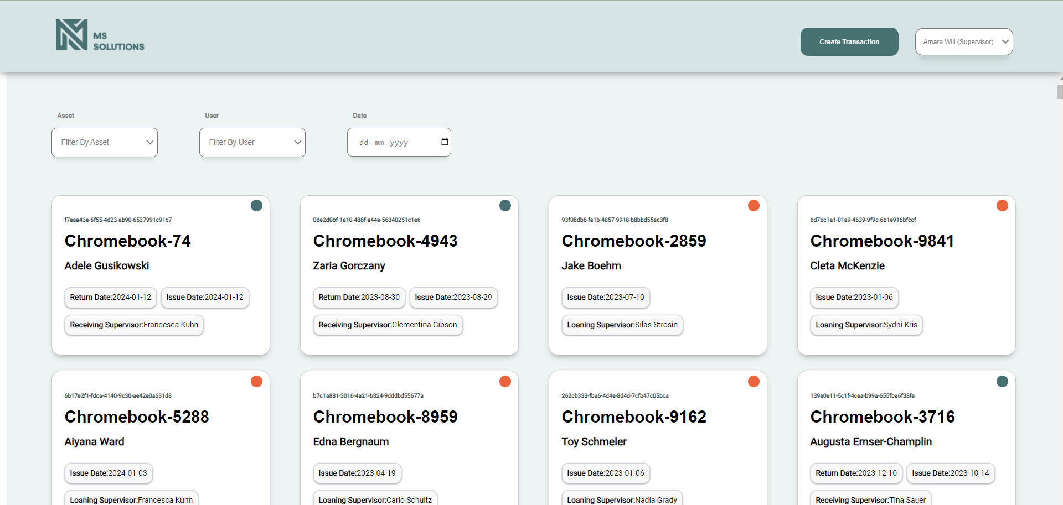
Home Page with default Supervisor

Slide 3
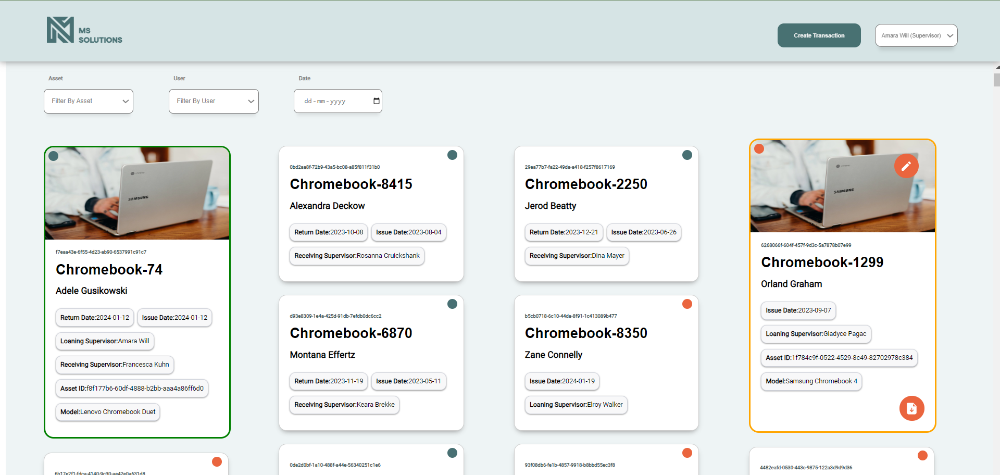
Cards Expanded

Slide 4
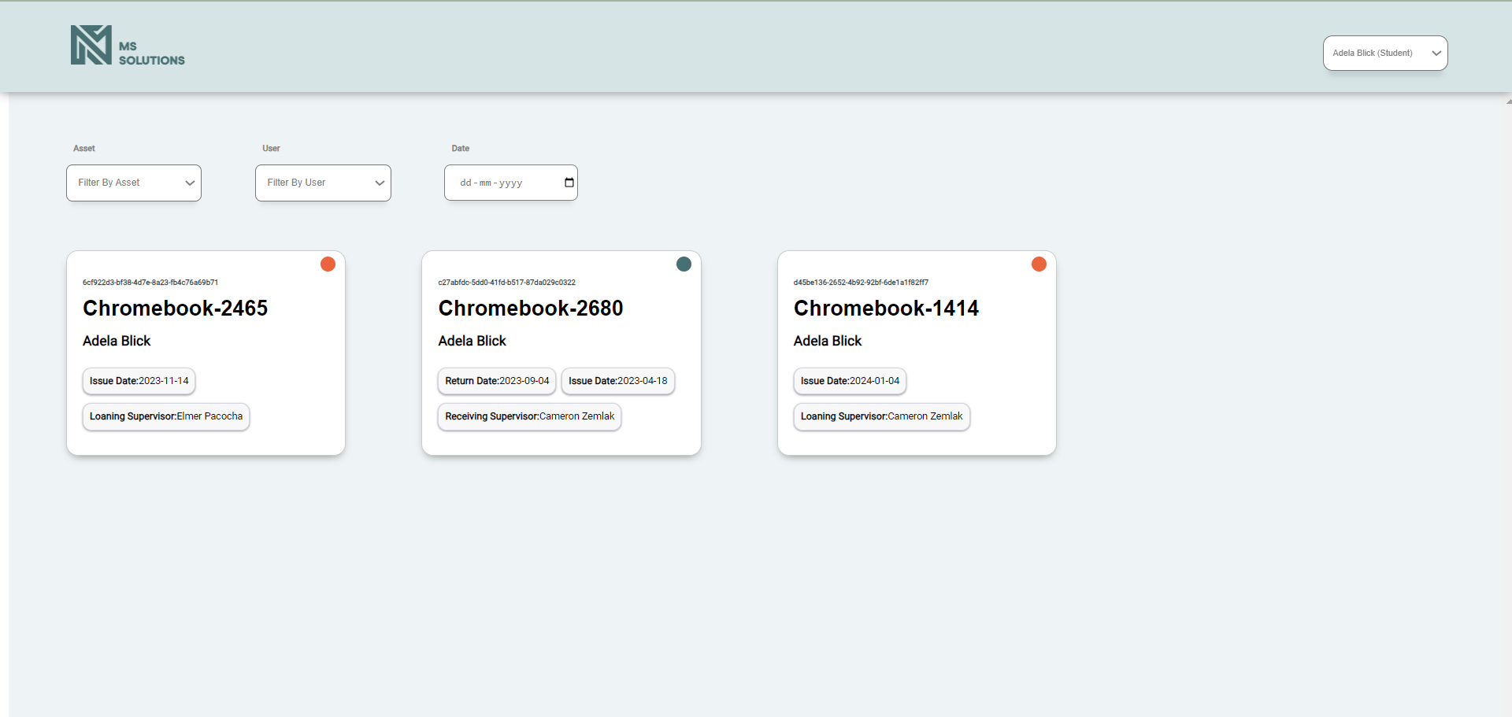
Student Screen

Slide 5
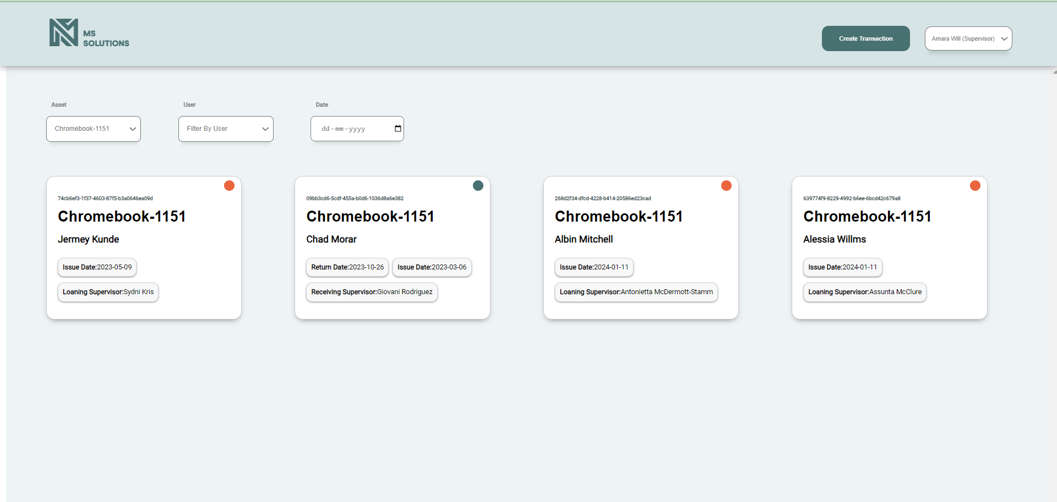
Asset Filter

Slide 6
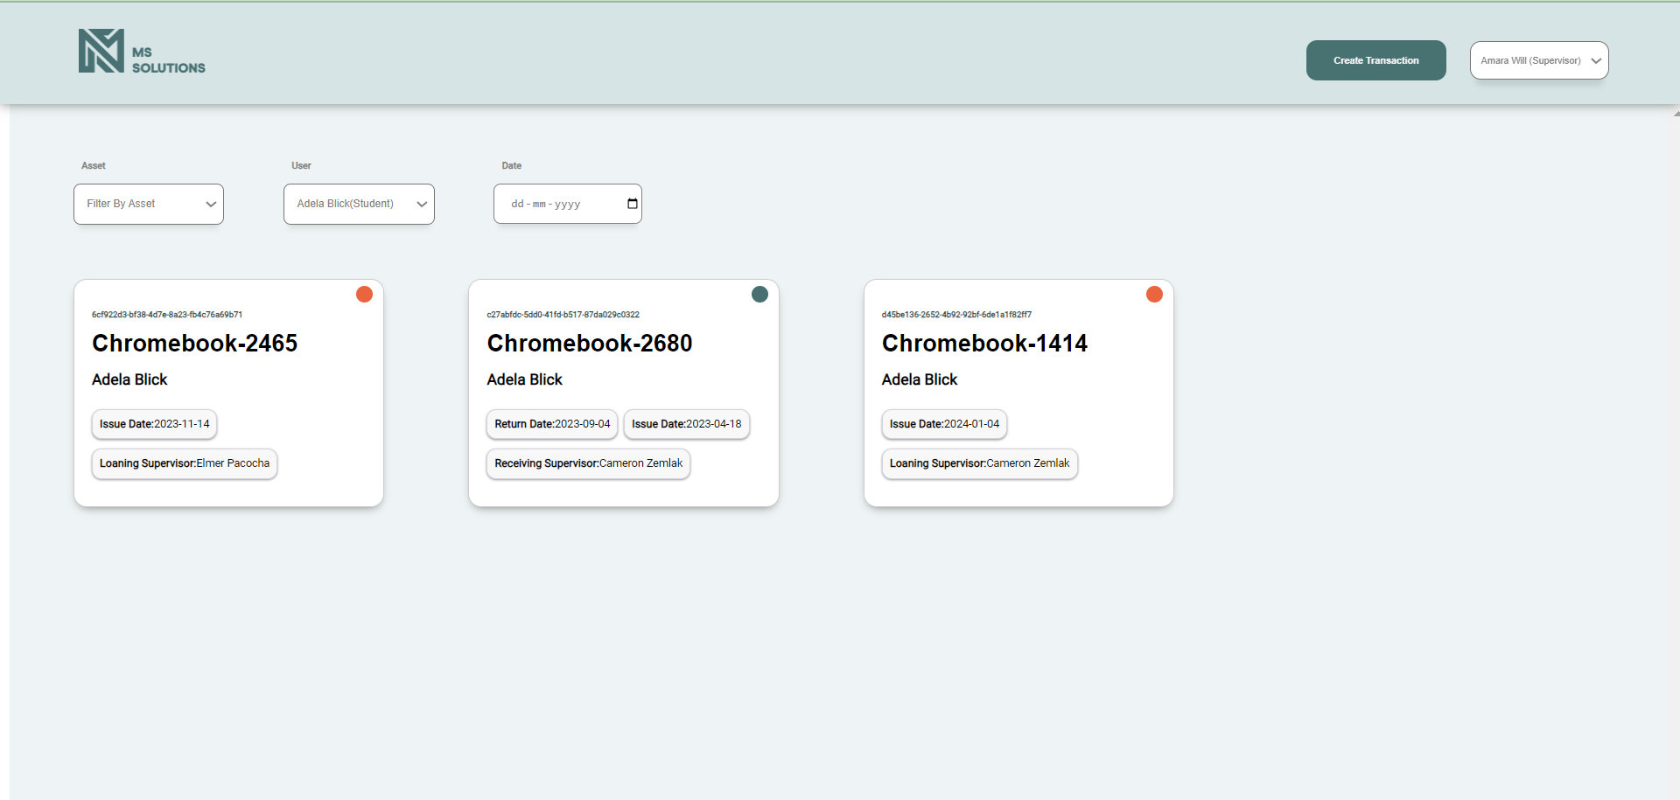
User Filter Form

Slide 7
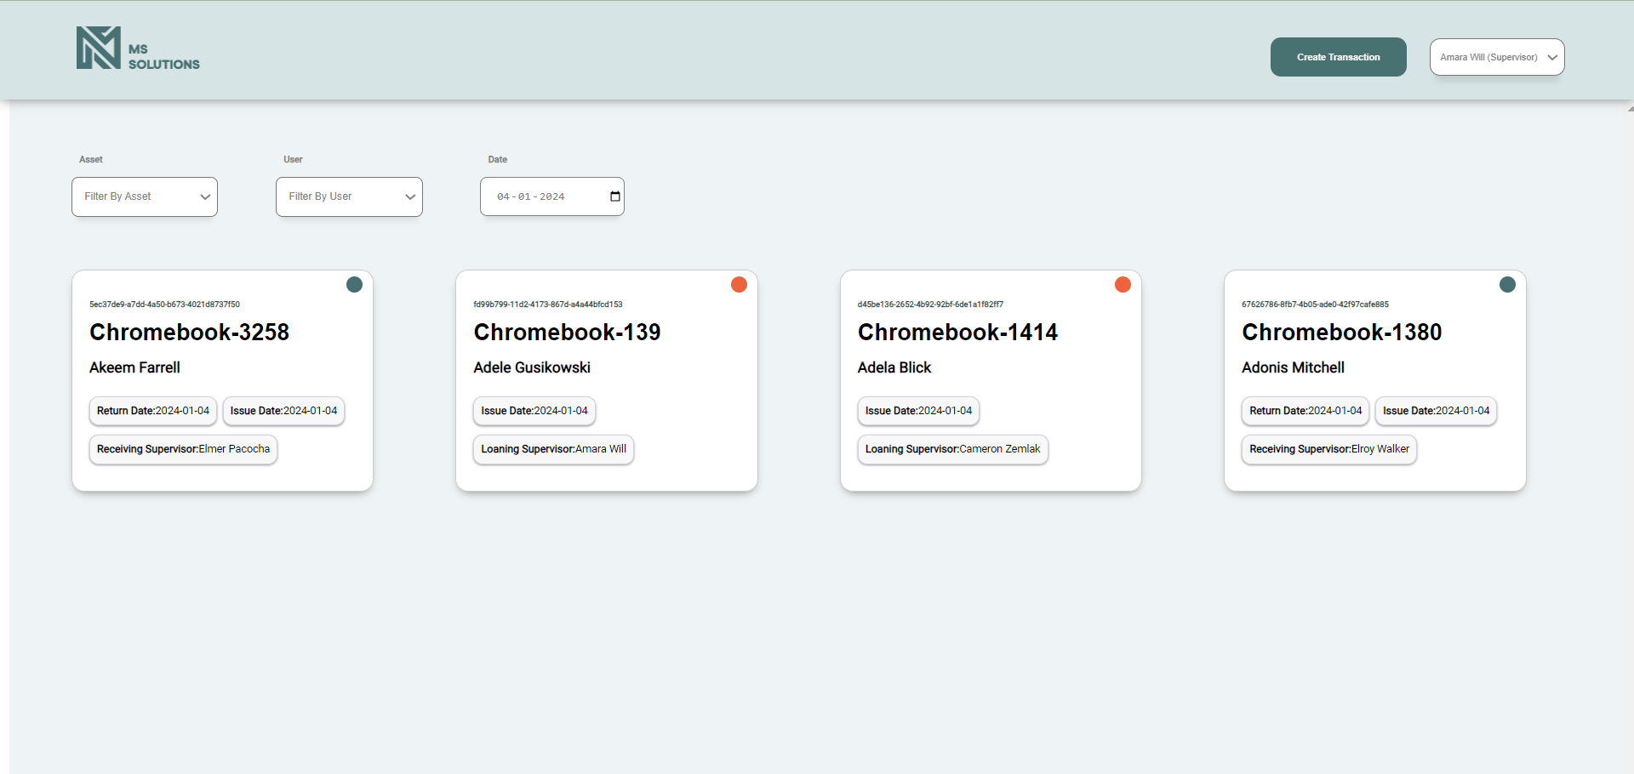
Date Filter

Slide 8
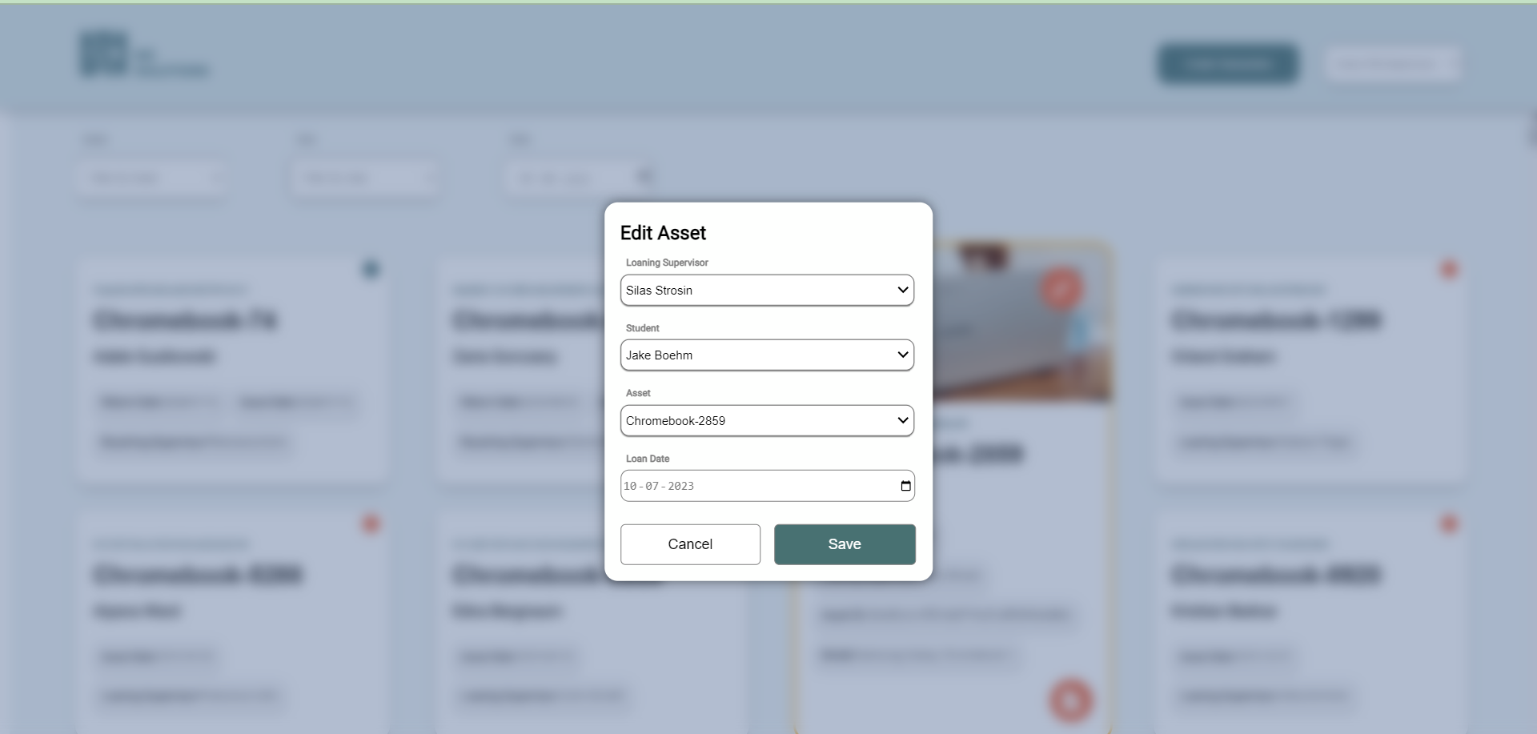
Transaction Edit Form

Slide 9
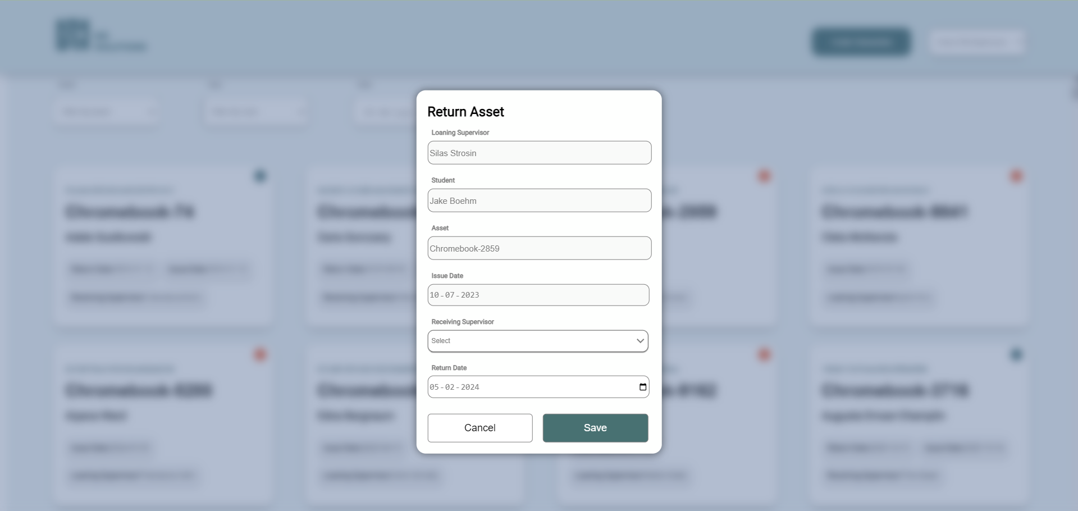
Transaction Return Form

Slide 10
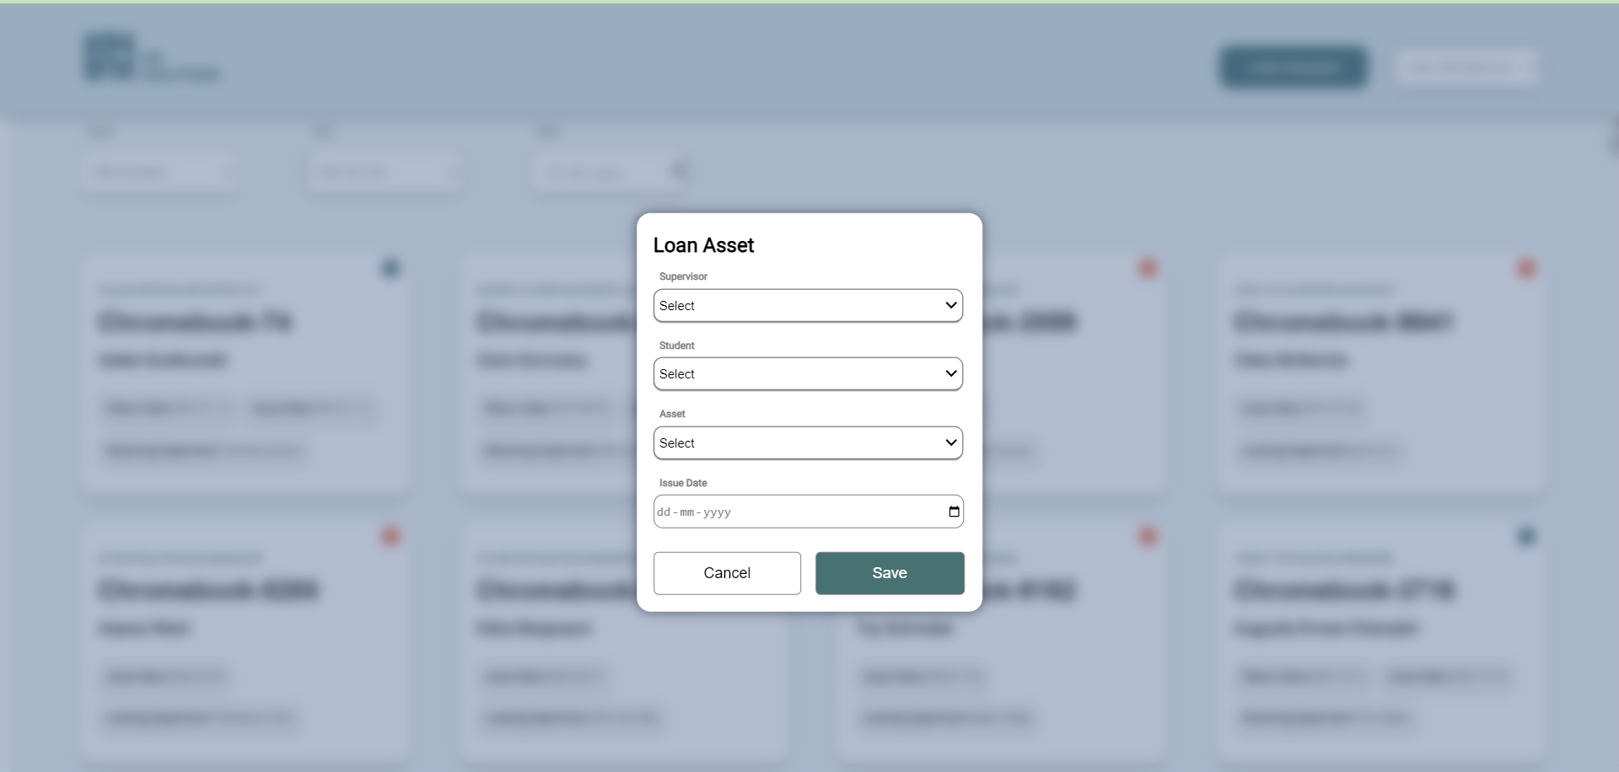
Loan Transaction Form

Slide 11
Thankyou

